Slide 1
Introduction to
Artificial Intelligence
Lecture: Introduction to AI

Slide 2
Outline
What is Artificial Intelligence (AI)?
The Foundations of Artificial Intelligence
The History of Artificial Intelligence
The State of the Art

Slide 3
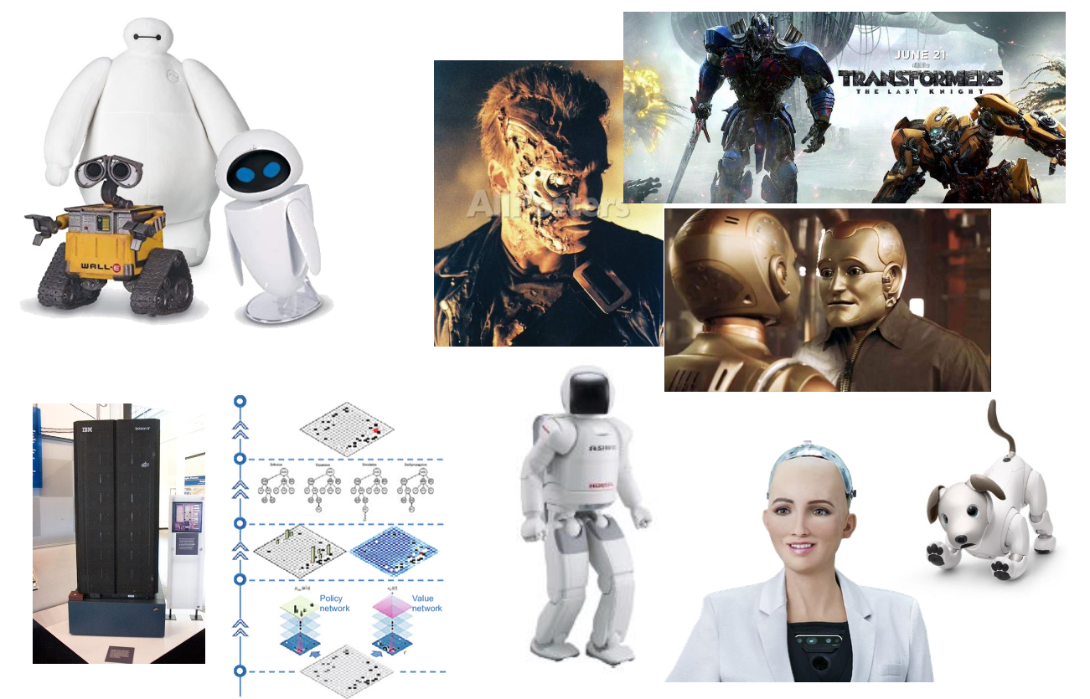
AI: Dreams for everyone

Slide 4
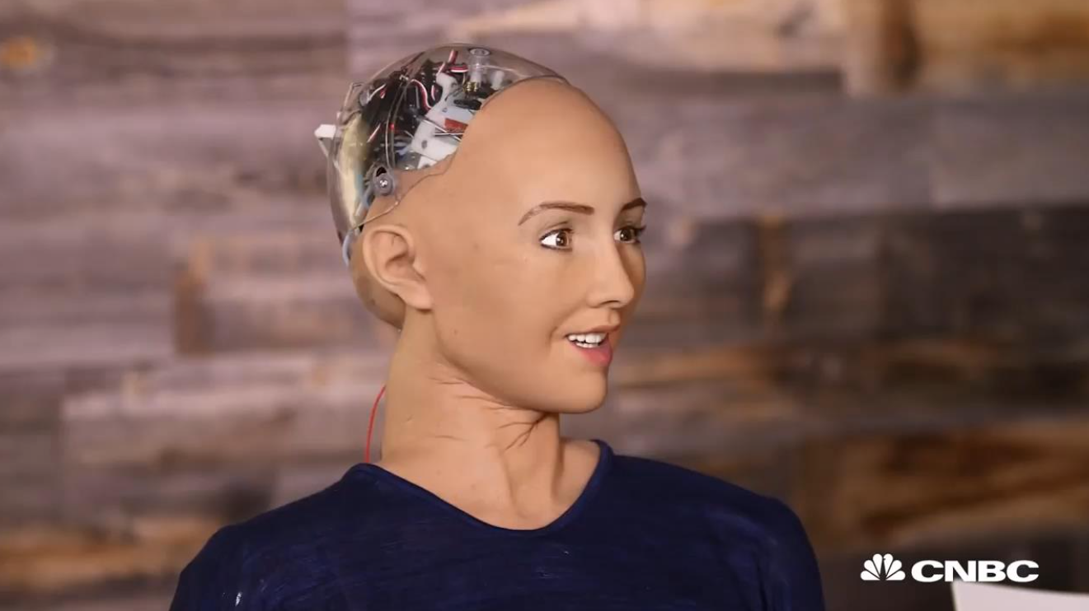
AI: Sophia Robot

Slide 5
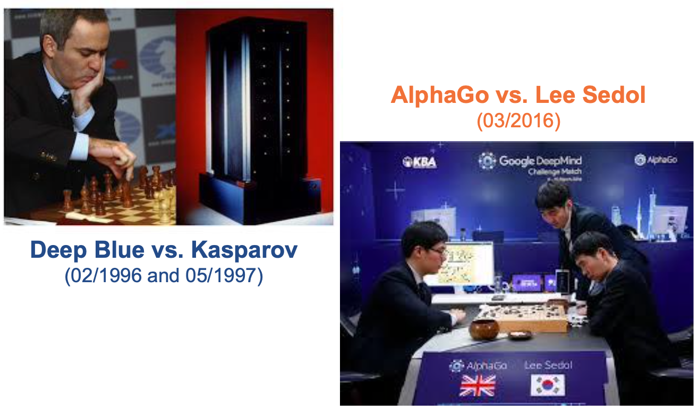
AI: Deep Blue – AlphaGo

Slide 6
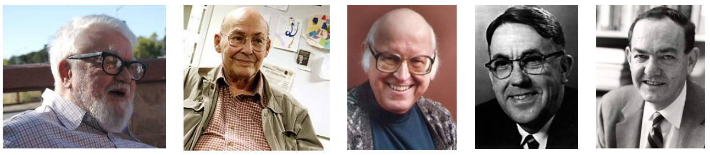
Intelligence vs. Artificial Intelligence
Intelligence includes the capacity for logic, understanding, learning, reasoning, creativity, and problem solving, etc.
Artificial intelligence (AI) attempts not just to understand but also to build intelligent entities.
John McCarthy Marvin Minsky Allen Newell Arthur Samuel Herbert Simon
(1927 – 2011) (1927 – 2016) (1927 – 1992) (1901 – 1990) (1916 – 2001)

Slide 7
The fields of AI
AI research aims to build intelligent entities that are capable of simulating humans in different aspects.
Thinking: learning, planning, knowledge refinement
Perception: see, hear, feel, etc.
Communication in natural languages
Manipulation and moving objects

Slide 8
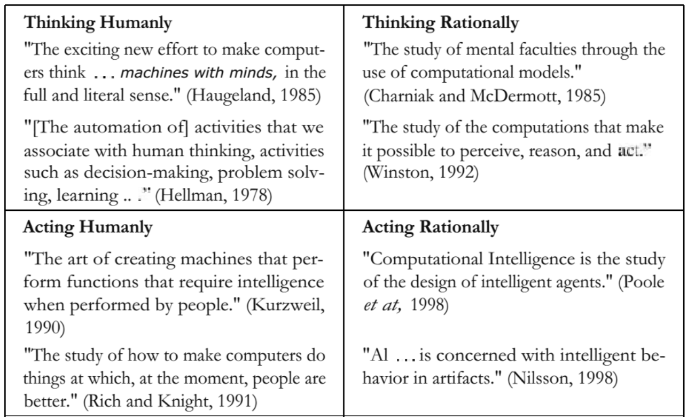
What is AI?

Slide 9
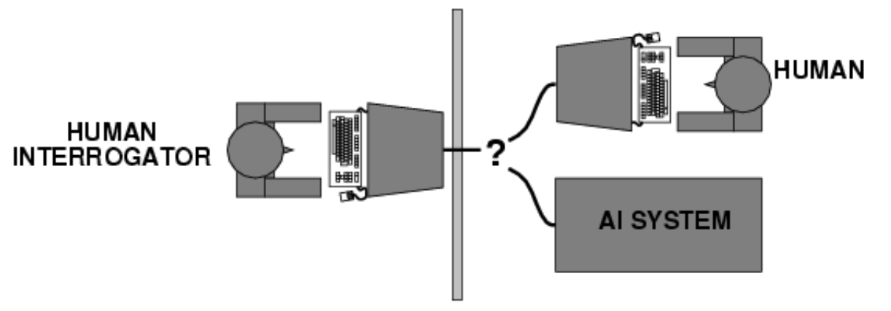
Acting humanly
The Turing Test approach (Alan Turing, 1950):
A computer passes the test if a human interrogator, after posing some written questions, cannot tell whether the written responses come from a person or from a computer.

Slide 10
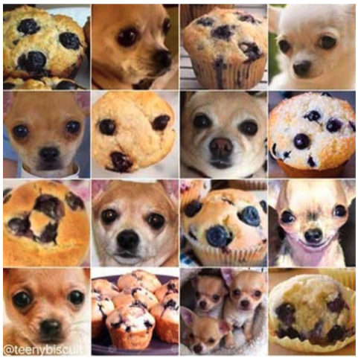
Acting humanly
Other Turing Test: Chihuahua and muffin

Slide 11
Thinking humanly
Cognitive modeling approach
The program’s input-output behavior matches corresponding human behavior.
We need to get inside the actual workings of human minds
Introspection: trying to catch our own thoughts as they go by
Psychological experiments: observing a person in action
Brain imaging: observing the brain in action

Slide 12
Thinking humanly
General Problem Solver – GPS (Newell and Simon, 1961)
Not merely solve problems correctly
Compare the trace of its reasoning steps to traces of human subjects solving the same problems
Cognitive Science
ComputermodelsfromAI
Experimental techniques from psychology
These approaches are now distinct from AI
Share the available theories but do not explain anything resembling human intelligence
All share a principal direction

Slide 13
Thinking rationally
The laws of thought approach
“Right thinking” = irrefutable reasoning processes
Example of Aristotle (381BC – 322BC)
Obstacles:
Not all intelligence is mediated by logic behavior
Solving a problem “in principle” is different from doing in practise.
All men are mortal. Socrates is a man. Therefore, Socrates is mortal. | ∀x.man(x)⇒mortal(x) man(Socrates) mortal(Socrates)

Slide 14
Acting rationally
The rational agent approach
Rational behavior = “doing the right thing”
The “right thing” is what is expected to maximize goal achievement given the available information.
An agent is just something that perceives and then acts
f: P* → A
A rational agent acts to achieve the best outcome or, when there is uncertainty, the best expected outcome.

Slide 15
Goals of AI
AI studies the intelligent part concerned with humans and represents those actions using computers.
Make computers more useful by letting them take over dangerous or tedious tasks from human
Understand principles of human intelligence

Slide 16
Related research fields
Field | Description
Philosophy | Logic, methods of reasoning, mind as physical system, foundations of learning, language, rationality.
Mathematics | Formal representation and proof, algorithms, computation, (un)decidability, (in)tractability, probability.
Economics | Utility, decision theory, rational economic agents
Neuroscience | Neurons as information processing units.
Psychology/ Cognitive Science | How do people behave, perceive, process information, represent knowledge.
Computer Engineering | Building fast computers
Control Theory | Design systems that maximize an objective function over time
Linguistic | Knowledge representation, grammar

Slide 17
Common topics in AI
Search (includes Game Playing)
Representing knowledge and reasoning with it
Planning
Learning
Natural language processing
Expert systems
Interacting with the Environment
Vision, Speech recognition, Robotics, etc.

Slide 18
Pros and Cons of AI
Pros:
More powerful and more useful computers New and improved interfaces
Solve new problems
Better handling of information
Relieve information overload
Conversion of information into knowledge
Cons:
Increased costs
Difficulty with software development - slow and expensive
Few experienced programmers

Slide 19
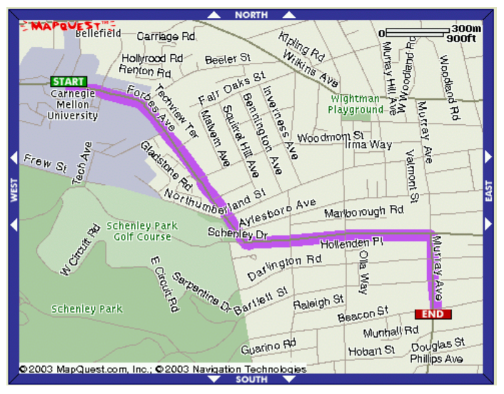
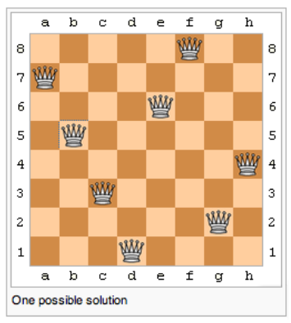
Solving problems by searching
Search is the fundamental technique of AI, either “uninformed” or “informed”.
Search for the first answer that satisfies our goal or keep searching until we find the best answer.

Slide 20
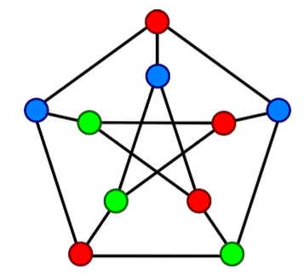
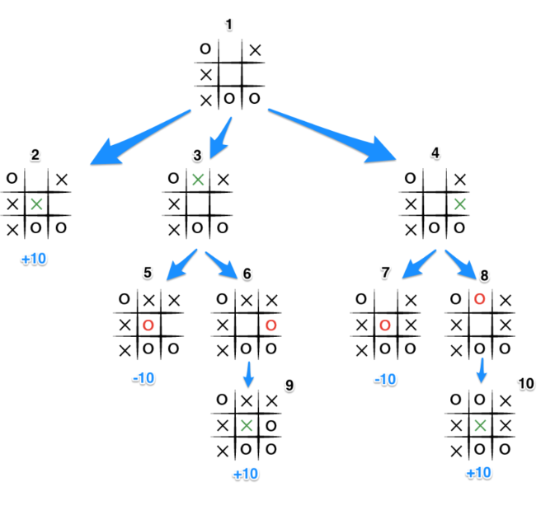
Solving problems by searching
Search is the fundamental technique of AI, either “uninformed” or “informed”.
Search for the first answer that satisfies our goal or keep searching until we find the best answer.

Slide 21
Knowledge and reasoning
To act rationally in our environment, then we must have some way of describing that environment and drawing inferences from that representation.
How do we describe what we know about the world ?
How do we describe it concisely ?
How do we describe it so that we can get hold of the right piece of knowledge when we need it ?
How do we generate new pieces of knowledge ?
How do we deal with uncertain knowledge ?

Slide 22
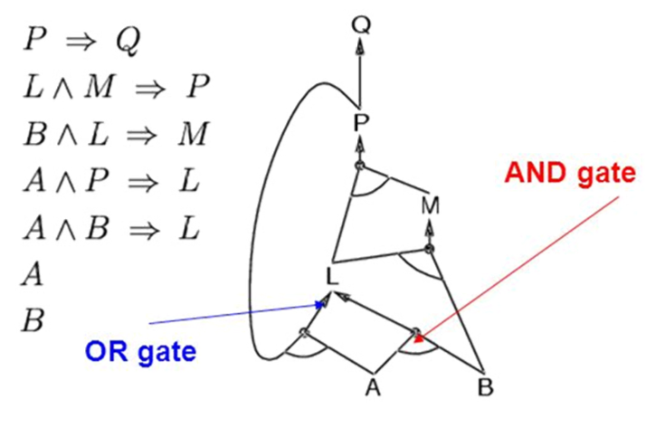
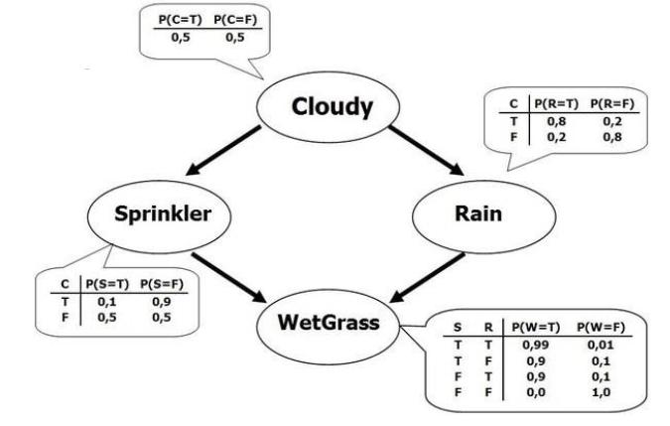
Knowledge and reasoning
Propositional logic and predicate logic
Inference techniques: forward chaining, backward chaining, and resolution
Uncertain knowledge and reasoning

Slide 23
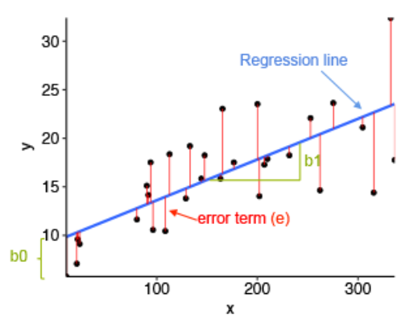
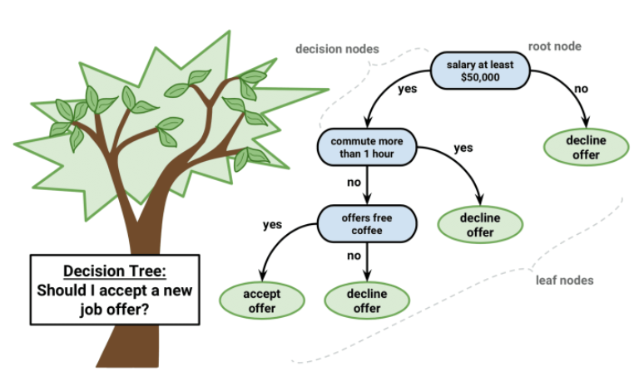
Machine Learning
If a system is going to act truly appropriately, then it must be able to change its actions in the light of experience.
How do we generate new facts from old ?
How do we generate new concepts ?
How do we learn to distinguish different situations in new environments?

Slide 24
History of AI
1940-1950: Early days
1943: McCulloch & Pitts: Boolean circuit model of brain
1950: Turing's “Computing Machinery and Intelligence”
1950—70: Excitement: Look, Ma, no hands!
1950s: Early AI programs, including Samuel's checkers program, Newell & Simon's Logic Theorist, Gelernter's Geometry Engine
1956: Dartmouth meeting: “Artificial Intelligence” adopted
1965: Robinson's complete algorithm for logical reasoning
1970—90: Knowledge-based approaches
1969—79: Early development of knowledge-based systems
1980—88: Expert systems industry booms
1988—93: Expert systems industry busts: “A Winter”

Slide 25
History of AI
1990—: Statistical approaches
Resurgence of probability, focus on uncertainty
General increase in technical depth
Agents and learning systems... “A Spring”?
2000—: Where are we now?

Slide 26
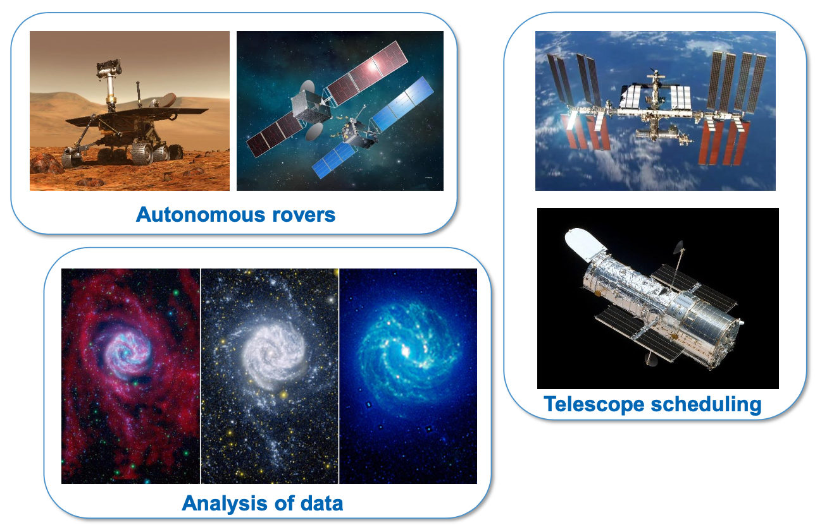
Recent advancements

Slide 27
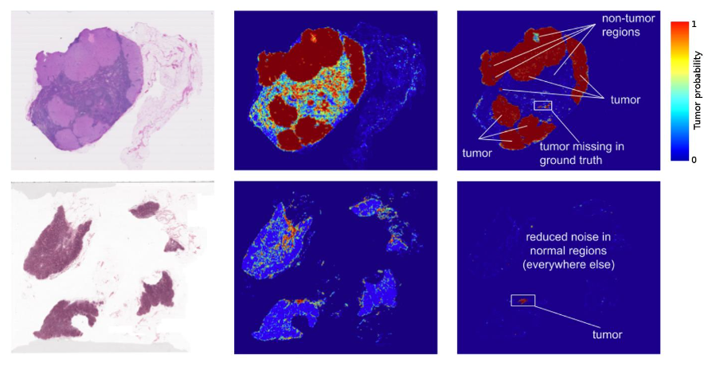
Recent advancements

Slide 28
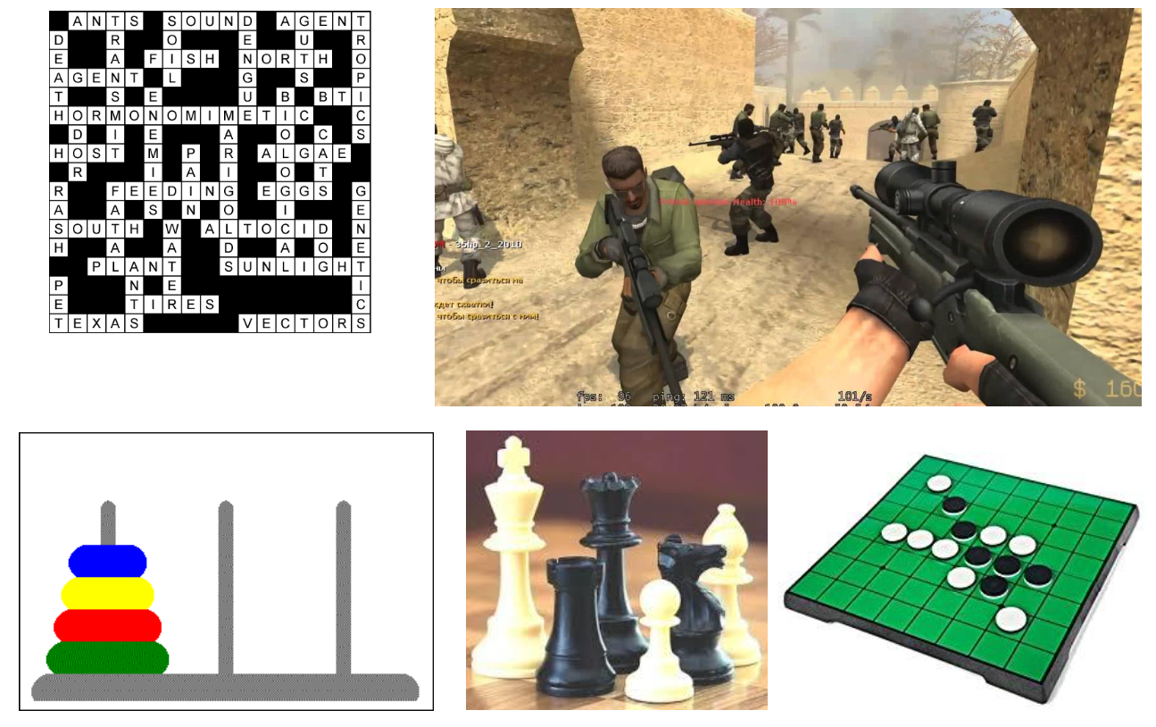
Recent advancements

Slide 29
Homework
Find 03 recent advancements in AI.
Briefly introduce the selected advancements.
Determine, as deeply as possible, the subfields of them.

Slide 30
References
Stuart Russell and Peter Norvig. 2009. Artificial Intelligence: A Modern Approach (3rd ed.). Prentice Hall Press, Upper Saddle River, NJ, USA.
Lê Hoài Bắc, Tô Hoài Việt. 2014. Giáo trình Cơ sở Trí tuệ nhân tạo. Khoa Công nghệ Thông tin. Trường ĐH Khoa học Tự nhiên, ĐHQG-HCM.
Nguyễn Ngọc Thảo, Nguyễn Hải Minh. 2020. Bài giảng Cơ sở Trí tuệ Nhân tạo. Khoa Công nghệ Thông tin. Trường ĐH Khoa học Tự nhiên, ĐHQG-HCM.

